Slide 1


Prepared by Amanda Scott
August 2020

Slide 2
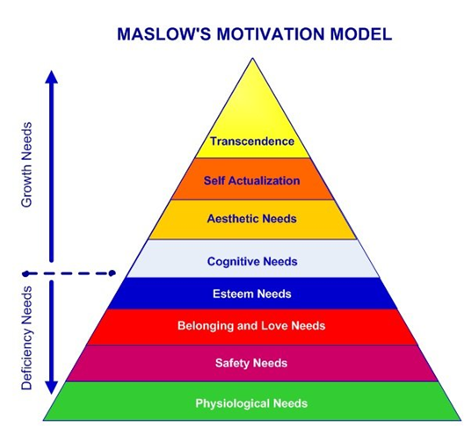
As a human we need to feel a reason to wake up in the morning, before we have a motive to Make Shift Happen. This is why we need to incorporate Hierarchy. Maslow’s Hierarchy demonstrates the motivation model outlining our deficiency or deprivation needs (“D-needs”) in that their lack of satisfaction causes a deficiency that motivates people to meet these needs. Physiological needs, the lowest level on the hierarchy, include necessities such as air, food, and water. These tend to be satisfied for most people, but they become predominant when unmet. The top level of the pyramid is considered growth needs. The lower level needs must be satisfied before higher-order needs can influence behavior.
https://www.learning-theories.com/maslows-hierarchy-of-needs.
McLeod, S. A. (2020, March 20). Maslow's hierarchy of needs. Simply Psychology. https://www.simplypsychology.org/maslow.html

Slide 3
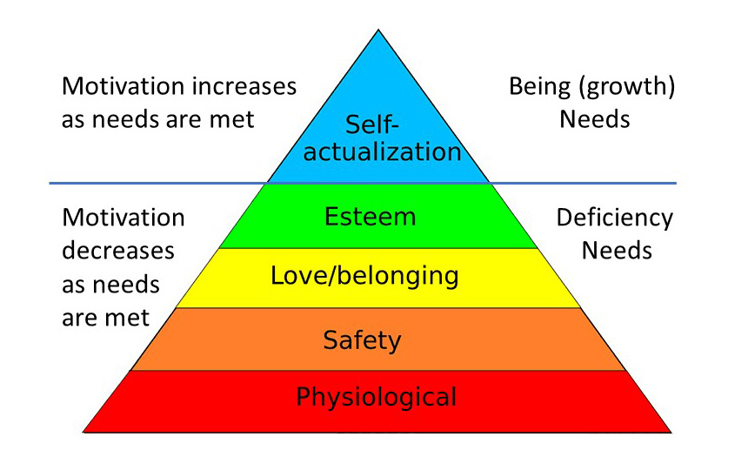
1. Biological and physiological needs - air, food, drink, shelter, warmth, sex, sleep, etc.
2. Safety needs - protection from elements, security, order, law, stability, freedom from fear.
3. Love and belongingness needs - friendship, intimacy, trust, and acceptance, receiving and giving affection and love. Affiliating, being part of a group (family, friends, work).
4. Esteem needs - which Maslow classified into two categories: (i) esteem for oneself (dignity, achievement, mastery, independence) and (ii) the desire for reputation or respect from others (e.g., status, prestige).
5. Cognitive needs - knowledge and understanding, curiosity, exploration, need for meaning and predictability.
6. Aesthetic needs - appreciation and search for beauty, balance, form, etc.
7. Self-actualization needs - realizing personal potential, self-fulfillment, seeking personal growth and peak experiences. A desire “to become everything one is capable of becoming”(Maslow, 1987, p. 64).
8. Transcendence needs - A person is motivated by values which transcend beyond the personal self (e.g., mystical experiences and certain experiences with nature, aesthetic experiences, sexual experiences, service to others, the pursuit of science, religious faith, etc.).

Slide 4
So How Can We Meet These Needs For The Vulnerable?
From our point of view, effective care means taking a more holistic approach, one that blends social connectedness with spirituality to care for vulnerable populations.
These programs value respect for personal dignity, autonomy and access to the general community, putting as much weight on these needs as on Maslow's first-tier needs, such as number of people served, meals eaten, and transportation and housing provided.
This approach is far more effective because it helps people become a part of a community. When people feel they are connected and not alone, research shows they have a greater sense of well-being and are better able to weather negative life events. In fact, there is empirical evidence that the need to belong is a fundamental human motivation. Belonging is a psychological lever that has broad consequences for people's interests, motivation, health and happiness.
increase sense of community

Slide 5
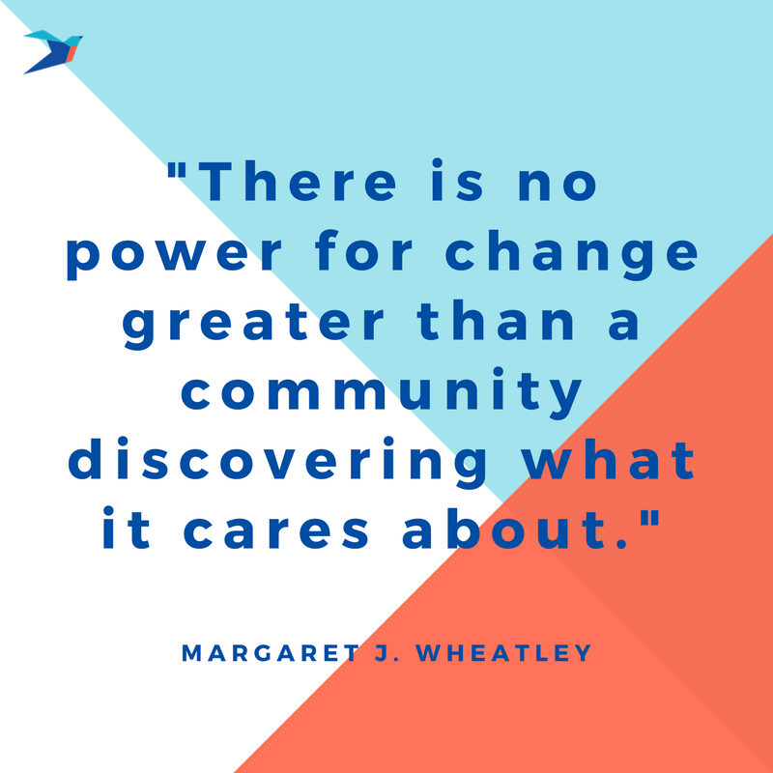

Slide 6
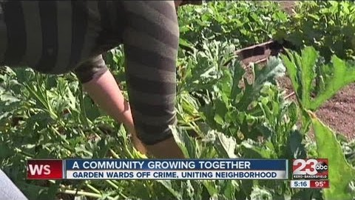
Community
Programing
Skills-oriented programs are among the most effective general strategies for reducing youth violence and risk factors for youth violence. In fact, two universal programs that take this approach have met the criteria for a Model program: Life Skills Training and the Midwestern Prevention Project.”
https://www.youtube.com/watch?v=XVUfDHEUKg0

Slide 7
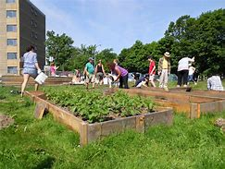
provided opportunities for constructive activities, contributions to the community, relationship and interpersonal skill development, informal social control, exploring cognitive and behavioral competence, and improved nutrition. Community gardens promoted developmental assets for involved youth while improving their access to and consumption of healthy foods
Community gardens are one way that residents have mobilized to beautify urban neighborhoods, improve access to fresh produce, and engage youth
Community Gardens
opening of a community garden has a statistically significant positive impact on residential properties within 1000 feet of the garden, and that the impact increases over time. We find that gardens have the greatest impact in the most disadvantaged neighborhoods
gardens give rise to a range of social processes, including social connections, reciprocity, mutual trust, collective decision-making, civic engagement and community building, all important processes associated with improving individual health and strengthening neighborhoods

Slide 8
Community gardens are collaborative projects on shared open spaces where participants share in the maintenance and products of the garden, including healthful and affordable fresh fruits and vegetables.
Gardens may offer physical and mental health benefits by providing opportunities to
Eat healthy fresh fruits and vegetables.
Engage in physical activity, skill building, and creating green space.
Beautify vacant lots.
Revitalize communities in industrial areas.
Revive and beautify public parks.
Create green rooftops.
Decrease violence in some neighborhoods, and improve social well-being through strengthening social connections.
https://www.cdc.gov/healthyplaces/healthtopics/healthyfood/community.htm

Slide 9

POWER IS THE ABILITY TO DO GOOD THINGS FOR OTHERS
-Brooke Astor

Slide 10
Mural Programs
The Council is a nonprofit corporation whose primary goal is to prevent graffiti vandalism and provide creative solutions that promote graffiti-free communities. The Council is funded by the aerosol coatings industry concerned about the negative impact of graffiti vandalism on America’s communities.
The Council shall provide information, education, and legislative assistance to help communities develop effective policies and comprehensive programs that prevent graffiti vandalism.
To fulfill its purpose, the Council will conduct research; gather and evaluate information; develop comprehensive strategies, policies, and programs; and provide implementation assistance designed to eliminate graffiti vandalism and promote positive, innovative anti-graffiti strategies for communities.

Slide 11
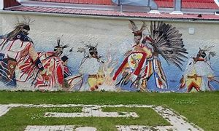

Slide 12
July 2019 – Jersey City, New Jersey – Street Art Thrives in Jersey City
Two new massive murals on Summit Avenue are the latest additions to the city by the Jersey City Mural Arts Program. The city currently has around 130 murals painted by local, national, and international street artists. Each mural is unique and individually speaks to the community, tells the history of the city, and reflects the culture of Jersey City’s varied neighborhoods. The city’s mural arts program started in 2012 as an offshoot of a larger, city-wide anti-graffiti program. Since then, it has blossomed into a greater initiative that continues to deter graffiti vandalism and encourage local artists to get involved in the community in a positive way. The program is led by a team of managers, artists, and administrators in the mayor’s office, the Department of Cultural Affairs, and the Department of Public Works, who work directly with neighborhood groups, educational institutions, small businesses, and private property owners to select ideal locations, artists, and content for the murals. The city has no intention of slowing down the proliferation of public art, either, as a dozen murals have already been commissioned to be painted over the next year.
Source: Hudson Reporter
July 2019 – Missoula, Montana – Students Paint a New Mural to Combat Graffiti
Local students are spending some of their summer vacation helping paint a new mural in downtown Missoula. The Flagship Program developed this mural arts project in coordination with the Missoula Parking Commission, Ace Hardware, and the Missoula Public Art Committee. The mural, which depicts ages of geologic history, is located in an area that frequently gets tagged with graffiti vandalism. The organizations commissioned this mural project in an effort to combat graffiti vandalism by beautifying the public space and supporting the community.
Source: ABC Fox Montana
https://www.anti-graffiti.org/cities-in-action/mural-programs

Slide 13
Enhanced Community Capacity
We commit to deliver services that respond to changing needs and demonstrate best possible outcomes. We foster community participation, collaboration, and action.
COMMUNITY BRIDGE PROGRAMS
OUR MISSION
To provide education, support and professional counselling programs to individuals and families to build and sustain more positive futures.
http://communitybridge.ca/

Slide 14
BABY’S BEST CHANCE PREGNANCY OUTREACH
The Baby’s Best Chance Pregnancy Outreach Program is a province-wide program that provides services for pregnant women and teens with lifestyle challenges or at risk of having at risk of having low birth weight babies. Services are offered in Fort St. John and Dawson Creek B.C.
learn more »
COMMUNITY BASED VICTIM SERVICES
The Community Based Victim Services program offers emotional support, court preparation and accompaniment, and assistance in completion of forms to women, children, and men in the Fort St John B.C area who have been victims of sexual and/or violent crimes.
learn more »
DADDY & ME PROGRAM
FREE Activities for children aged 0-6 and their dads, grandpas, uncles & caregivers.
learn more »
DOMESTIC PEACE PROGRAM
This program is for parents/caregivers and their children who have become involved with MCFD (Ministry of Children & Family Development) child protective services due to the unhealthy or controlling behaviours they are using or experiencing in their family relationships.
learn more »
FAMILY ADVANCEMENT
This is a free counselling service for children/adolescents age 3-19 and their families for anxiety, behaviour problems, grief and loss issues, anger management and relationship and communication problems.
learn more »
FAMILY PRESERVATION
The Family Preservation program provides support to children and families in Fort St John B.C, Dawson Creek B.C and areas who are referred by the Ministry for Children and Family Development.
learn more »

Slide 15
FOSTER PARENT RECRUITMENT, RETENTION AND SUPPORT
The Foster Parent Support program is dedicated to providing support for foster parents.
learn more »
HOMELESSNESS PREVENTION PROGRAM
This program provides services to help people who are living in absolute homelessness, hidden homelessness (temporary housing), or who are at-risk of homelessness (temporarily housed, couch surfing, or soon to be evicted). We aim to connect clients with housing options and the support needed to help them move up through the housing continuum.
learn more »
MEAOPE TRANSITION HOUSE
The Meaope Transition House program provides safe shelter, meals, and short-term support to women and their children who are experiencing family violence, personal crisis, or are at risk due to homelessness.
learn more »
MOTHER GOOSE PROGRAM
This program offers a group experience for parents and their infants and/or toddlers, focusing on personal interaction through rhymes, stories, and song. Parents gain skills and confidence which can enable them to create positive family patterns during their child’s crucial early years. Children benefit from healthy early experiences with language and communication.
learn more »
PEACE PROGRAM FOR CHILDREN AND YOUTH EXPERIENCING VIOLENCE
The PEACE Program for Children and Youth Experiencing Violence program provides individual and group counselling for children 3 – 18 years of age who have experienced or witnessed violence, threats, or abuse in the home.
learn more »
SEXUAL ABUSE INTERVENTION
The Sexual Abuse Intervention Program provides services to children and youth who have been victims of sexual abuse.
learn more »
STRENGTHENING FAMILIES PROGRAM
The Strengthening Families program is a free 14 week multi-cultural family skills training program for families with children aged 6-12 years old. Parenting skills are enhanced so that parents are able to meet the needs of their children and improve sibling, parental, and family relationships.
learn more »

Slide 16
SUPPORTED INDEPENDENT LIVING PROGRAM FOR YOUTH
The Supported Independent Living program assists youth in Fort St John and Dawson Creek B.C to become independent during the transition into adulthood.
learn more »
TEACHING HOME SUPPORT
The Teaching Home Support program provides household management as well as training in household management when needed. The program serves families referred by the Ministry for Children and Family Development in the Fort St. John, Dawson Creek, Chetwynd and Tumbler Ridge B.C areas.
learn more »
WOMEN’S COUNSELLING (STOPPING THE VIOLENCE)
This Women’s Counselling program provides counselling for women ages 19+, in Fort St John and area, who have experienced sexual assault, any form of violence or abuse in a relationship, child abuse, and/or childhood violence.
learn more »
WOMEN’S OUTREACH
The Women’s Outreach program provides emotional support and practical assistance to women in the Fort St John area who have experienced violence, abuse, or threats within the previous 6 months.
learn more »
YOUTH FORT ST. JOHN (YFSJ)
This program provides positive role models for youth through facilitated group and individual activities designed to enhance the youth’s social and emotional life skills and improve the quality of their relationships at home, at school, at work and in the community.
learn more »
YOUTH JUSTICE ACT
This program provides individual, family, and group counselling for youth in the Fort St John and Dawson Creek B.C. areas who are involved in the Criminal Justice System.
learn more »
ctrl+click to follow the link

Slide 17

The John Howard Society of Manitoba stands in solidarity with people around the world who are standing up to fight systemic racism and police brutality, and affirms the lives of Black and Indigenous people, both here in Manitoba and elsewhere in Canada.
http://johnhoward.mb.ca/
We offer continuous support as they re-establish and maintain their roles as workers, students, parents, and community members. We are a one-stop shop for men involved in the justice system in Manitoba. We assist with individual community referrals, programming and support.

Slide 18
Summary of our Services
We offer clothing and hygiene items, available to clients who need them
Providing information and community resource referrals for clients
Provide assistance with Birth Certificate (note: some restrictions apply)
Employment referrals and resources
Plans for education, such as adult learning centres, post-secondary, or other training
Referrals to addictions treatment program
Finding community supports and resources for family members
Our Clients
Our community clients include people who just got out of jail as well as those who have been out for years. Anybody can use our services as long as they are male who has currently or formerly been involved in the justice system.

Slide 19
Clothing Closet
“We Fit You Closet,” where clients in the community can visit to pick up clothing. We have mostly casual clothing – t-shirts, jeans, and sweaters – as well as, coats, and winter wear. Work boots are also available, with a letter from an employer stating employment.
We also have hygiene items, which include basic toiletries for individuals that are reintegrating from institution to community.

Slide 20
Programs
All programs are continuous and are offered on a rotation and are FREE of charge.
Positive Parenting Program
The Positive Parenting Program (Triple P) is a preventatively oriented program that aims to promote positive, caring relationships between parents and their children. The program aims to help parents develop effective management strategies for dealing with a variety of childhood behavioural and emotional problems and common developmental issues (Triple P, 2013).
The John Howard Society of Manitoba offers this course to fathers in the community, and it is offered in a group setting.
End to Aggression
End to Aggression is a program designed to help participants avoid further assaultive and/or aggressive behaviour by understanding how the way we think affects how we feel and ultimately affects our actions (Government of Manitoba, 2011).
Introduction to Healthy Relationships
Introduction to Healthy Relationships provides participants with information about healthy relationships, healthy and unhealthy behaviour within relationships, and tools to promote behavioural change. This is an informational program and not a treatment option (Government of Manitoba, 2015).

Slide 21
Coming To Terms
The Coming To Terms (CTT) program provides information to its participants that will assist them in evaluating their use of alcohol and other drugs, and the consequences that it may pose on their lives, as well as the lives around them. It aims to develop self-awareness and progression through the Stages of Change (Manitoba Corrections, 2010).
Healing and Harm Reduction Substance Abuse Program
The John Howard Society of Manitoba is pleased to announce it has received three-year funding from Health Canada’s Substance Use and Addictions Program to develop and implement a “Healing and Harm Reduction Substance Abuse Program” in Winnipeg.
Indigenous Elder services
The agency has been approved for funding in the amount of $476,798 for a period of 39 months to create a new program that includes weekly open support groups, case management, and Indigenous Elder services.
“We expect this program to play a crucial role in the healthy reintegration of formerly incarcerated individuals back into their families and communities,” said Sharon Perrault, Acting Executive Director of the John Howard Society of Manitoba.
Open-group format
The open group will rotate through a series of 16 topics related to substance use, trauma, the Indigenous experience, and harm reduction strategies for problematic substance use. The sessions will include information, activities, opportunities for sharing, and Indigenous teachings and ceremonies.
The program addresses the isolation from culture, community and services experienced by Indigenous men due to their trauma and subsequent problems with substance abuse and the law.

Slide 22
Culturally-based programming
“Our goal with this program is to provide culturally-based substance abuse programming that speaks to and is informed by the Indigenous experience,” said Perrault.
Funding includes allocation for evaluation of the program and the creation of program manuals that can be adopted by other agencies.
The program is currently in the development stage. More announcements are forthcoming.

Slide 23
Things We Offer
– a personal development workbook series, which helps clients improve their literacy skills while at the same time learning about topics of interest, such as parenting, victim awareness, and substance use
– opportunities to improve basic literacy and numeracy skills through one-to-one tutoring sessions with volunteers, inmate peer tutors, and JHS staff
– opportunities to study for the GED or brush up on math, English, sciences and social studies in preparation for a return to school
– referrals to adult literacy programs in the community
– peer tutor training for inmates or bail program residents who are interested in working with and mentoring their lower-literacy peers
– a lending library of fiction, non-fiction and magazines
http://johnhoward.mb.ca/

Slide 24

IN YOUTH WE LEARN; IN AGE WE UNDERSTAND

Slide 25
Addressing Youth Gangs & Violence
Gang-involved youth are considered to be some of the main perpetrators (and victims) of crime and violence, and impose a high burden on society in terms of criminal justice system and other societal costs.
Populations most at risk:
Indigenous Youth
Black Youth
Immigrant Youth
Young Woman
Youth who become involved in gangs often posses a high number or risk factors prior to gang membership.

Slide 26
Option I-The Wraparound Approach:
The Wraparound approach has been implemented in the United States and Canada throughout the 1990s, as well as more recently (Debicki, 2011). Wraparound is an intensive, individualized care management program designed for youth with serious or complex emotional and/or behavioural problems.
The Wraparound approach seeks to provide more extensive and proactive contact between the youth, his or her family, and other involved parties (e.g., court counsellor, social worker, etc.). Wraparound is focused on providing a continuum of services and support networks with case management coordination.
A focus on individualized and needs-based care can ensure that the necessary services are identified and accessed to meet the unique needs of each participant.
Key Implementation Components
A collaborative, community-based interagency team designs, implements, and oversees the project. Professionals from at least three of the following partners should be involved: child welfare services, mental health services, substance abuse services, family services, police, school, youth justice system, employment program, community organization (recreational, youth centre). One organization takes the lead in coordinating each individual Wraparound case.
A formal interagency agreement sets out who the target population for the initiative is; how they will be enrolled in the program; how services will be delivered and paid for; what roles different agencies and individuals will play; and what resources will be committed by various groups. This is commonly referred to as a 'system of care'.
Care coordinators who are responsible for helping participants create a customized treatment program for guiding youth and their families through the system of care. Care coordinators are usually employees of the lead agency. The care coordinator ensures the mobilization of partners, supervisions and support of workers, and overall project coordination.
Child and family teams (comprised of family members, paid service providers, and community members such as teachers and mentors) are created for each participant in the program. This team is a group of people – chosen in consultation with the family and connected to them through natural, community, and formal support relationships – who know the youth and his/her complex needs and work in partnership to ensure that the young person's needs in all life domains are addressed with cultural competence. This team develops and implements the plan of care.
There is an assessment of needs and development of a youth driven comprehensive plan of care, which is updated continually. This plan of care identifies the young person's unique strengths and weaknesses across domains, targets specific goals and proposes action plans. The plan of care addresses the roles of individual team members (young person and family included) in helping achieve the goals.
To achieve the goal laid out in the Wraparound plan of care, the team develops and implements a customized set of strategies, supports and services based upon availability and existing resources, such as employment support, pro-social activities (sport, music, etc.), school support, personal development (theme-based workshops, self-esteem). The care coordinator assesses the youth and develops and implements each person's intervention plan. This person is trained to coordinate the Wraparound process for a family.

Slide 27
Lessons Learned from Wraparound Experiences
Evaluations suggest a number of lessons learned from the development and implementation phases of the Wraparound approach (Debicki, 2011; Kamradt, 2010; Smith-Moncrieffe, 2013). These include:
The importance of developing a comprehensive map of community assets;
The importance of setting realistic expectations for the project;
The importance of practicing Wraparound and ensuring that service providers understand what this entails;
Getting access to services in a timely fashion requires relationship-building and persistence;
A strong system of partnerships is necessary to implement the Wraparound process effectively;
The community and the partners must work together towards a common goal with each child, youth, adult and their family;
Facilitators require good clinical teaching or coaching so that they are implementing the model faithfully and effectively; and
Children, youth, adults and their families must be connected to community groups to help them re-establish positive social networks so they can rebuild a supportive safety net.

Slide 28
Option II-Gang Reduction Program:
Theory:
The GRP is a comprehensive, integrated, multifaceted and coordinated approach that outlines the importance of addressing the needs of individual youth and making changes in the families, organizations, and communities. The GRP concentrates on assessing the needs of youth and providing them with individualized support services and suppression by involving their families, local organizations, and their communities.
Key Implementations:
The GRP consists of five core strategies which originate from integrated and team-oriented problem solving. The fundamental basis of the GRP is that a lack of social opportunities and the degree of social disorganization in a community contribute the youth gang problem.
Community mobilization – involving the community in responding to the gang problem.
Social intervention – addressing social deficits and issues, such as mental health issues, family dysfunction, substance abuse, and other factors that will diminish a gang member's ability to disengage from the gang.
Opportunities provision – engaging gang members in educational and employment opportunities.
Gang suppression – reducing the ability of gangs to cause harm to the community.
Organizational change and development – improving the ability of organizations and agencies to respond to gangs.

Slide 29
Key Findings in the Gang Reduction Program:
Strong leadership of a site coordinator, close oversight by the National Gang Centre/OJJDP during the strategic planning and implementation phases, and the availability of technical assistance contributed to implementation progress at the sites;
The lead organization should ensure proper analysis of community needs and knowledge of existing services, resources, and organizations available to youth at risk of gang involvement; and
Implementation sites should be in a position to demonstrate a sufficient level of readiness.
Past evaluations have demonstrated that communities who did not complete a community assessment and clearly identify the problem to be addressed had difficulty mobilizing the community and experienced implementation difficulties.
Strategies
To help communities understand and define their unique gang situation, an assessment should answer the following questions (inspired by Howell, 2010):
Who are the individuals involved in gangs and youth violence and what are their risk/protective factors?
Who are at the greatest risk of joining gangs and what are their risk/protective factors?
What is the history of these gangs in the community?
What crimes are committed by these gangs, when, where ('hot spots') and why?
What services (direct or related) are currently available to address the problem in the community and where are there gaps?
Reference:
https://www.publicsafety.gc.ca/cnt/rsrcs/pblctns/2018-ddrss-yth-gngs-vlnc/index-en.aspx

Slide 30
Youth Violence
Background information:
This program is a result of the close partnership between various public agencies (i.e., police, probation) and community organizations (i.e., street workers, religious organizations) working with the client group. Youth-serving organizations and criminal justice agencies collaborate to balance intensive supervision with comprehensive therapeutic support. Youth are provided with increased supervision to help them access important resources (e.g., employment, mentoring, school bonding, counselling, health care and drug treatment). The program also seeks to stabilize the families of participants through efforts such as jobs for parents and housing assistance.
Key Implementations:
Surveillance – Joint police-parole officers maintain close surveillance of the youth's activities to ensure that they obey the conditions of their release.
Measures to facilitate social reintegration – Community outreach workers develop a meaningful rapport with the youth and guide them toward resources to help them get off the streets. The YVRP provides participants with resources such as mentoring, healthcare, drug treatment, career counselling, and employment assistance. These community outreach workers also help the parents of the youth find jobs, housing, and healthcare.

Slide 31
Findings:
A smaller staff-to-student ratio would ensure better service delivery and increase the effectiveness of counselling (including more one-on-one sessions).
The necessity of engaging families in support of youth is critical. Like approaches to youth, supports to families should be individualized, strength-based, flexible, and based on trust.
When possible, youth should be consulted in program planning, implementation and knowledge dissemination.
Admitting youth that are not at-risk or are 'too low' of a risk will result in a trend that may erroneously conclude that the project was ineffective.
Projects seeking to support gang-involved or at-risk youth should allow for the customization of interventions based on needs. Flexibility in approaches is a key factor.

Slide 32
Youth Gang Program Interventions with Favourable Impacts
Contribution to Favourable Change in Attitudes | Contribution to Favourable Change in Risk and Protective Factors | Contribution to Favourable Change in Behaviours
Awareness raising activities related to gang risks and recruitment | Awareness raising activities related to gang risks and recruitment | Awareness raising activities related to gang risks and recruitment
Case management | Case management | Case management
Counselling | Counselling | Counselling
Drugs, alcohol and/or addictions education | Drugs, alcohol and/or addictions education | Drugs, alcohol and/or addictions education
Employment training and/or support | Employment training and/or support | Employment training and/or support
 |  | Healthy relationships (with peers)
Learning and education training
Life management and decision-making (life skills) | Life management and decision-making (life skills)
**Arts (music and crafts) | **Arts (music and crafts)
**Cultural activities and community service learning | **Cultural activities and community service learning | **Cultural activities and community service learning
 |  | **Sporting / recreation activities
Implementing two or more interventions in order to build a customized approach to addressing youth gangs and youth violence.
Note: Interventions with denoted ** should be combined with at least one of the other options listed above.

Slide 33
Crime Prevention Through
Environmental Design

Slide 34
Crime Prevention Through Environmental Design (CPTED) is based on the principle that proper design and effective use of buildings and public spaces in neighborhoods can lead to a reduction in the fear and incidence of crime, and an improvement in the quality of life for citizens.

Slide 35
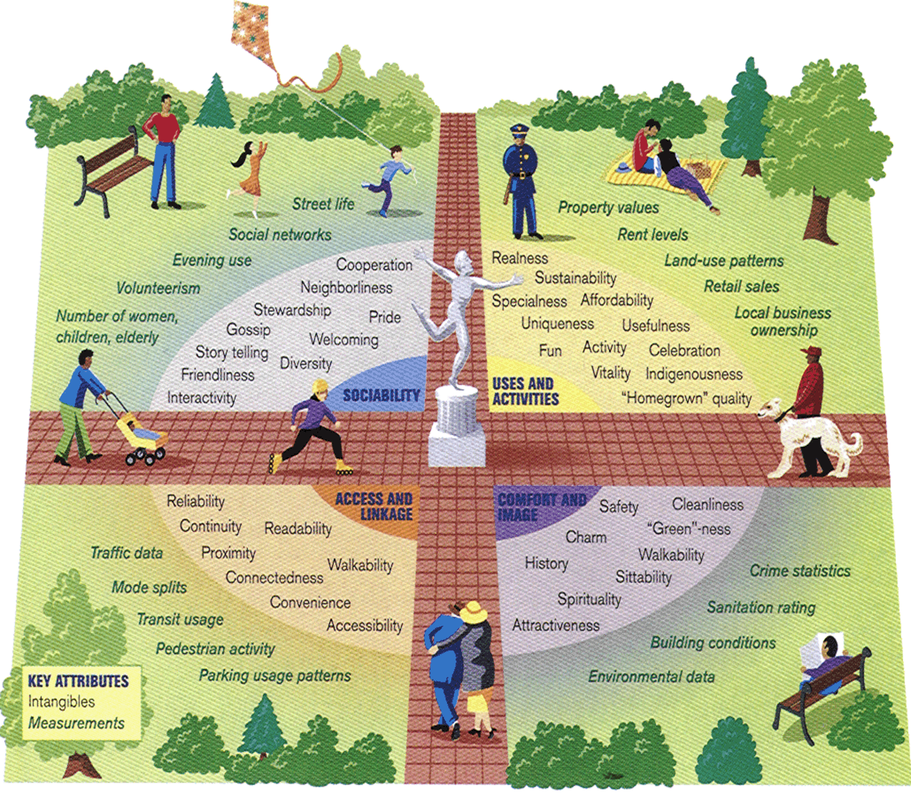
synergy
between urban form,
crime,
and social conditions

Slide 36
Implementing CPTED
In existing communities this is best done by a CPTED practitioner who has practiced many years of crime prevention and has completed several CPTED projects. With the assistance of community leaders, crime prevention advocates and input from community members to investigate the root causes of crime, combined with CPTED will greatly help with proper implementation.
In new communities CPTED is best implemented at the development stage and continued through the design and implementation stages.

Slide 37
Community residents will have
Opportunities to play meaningful roles in community crime prevention
Improved sense of security and quality of life through reduced fear of crime
Fewer crimes committed in neighborhoods, fewer victimizations of residents
Increased interaction among residents and stronger neighborhood bonds
New crime prevention and problem-solving skills and enhanced knowledge of city government agencies and other resources
Municipal leadership will see
Less crime in neighborhoods and business areas
Improved perception of safety and livability in public areas and neighborhoods
Enhanced consideration of public safety in planning, development, and redevelopment projects
Benefits of CPTED
https://www.ncpc.org/resources/home-neighborhood-safety/crime-prevention-through-environmental-design-training-
Business leaders/owners will gain
Safer locations that are more attractive to customers and employees
Enhanced problem-solving partnerships with local government and community members
Law enforcement will benefit from
Sustainable links with planning, development, code enforcement, and other local agencies
Clarification and action on neighborhood priorities related to crime and quality of life
Opportunities to play meaningful roles in community crime prevention
New crime prevention and problem-solving initiatives
Planners/architects will gain
A greater role in designing the environment; CPTED is recognized as an acceptable component of LEED (Leadership in Energy and Environmental Design) or Green Building
A holistic approach to the development and planning process

Slide 38
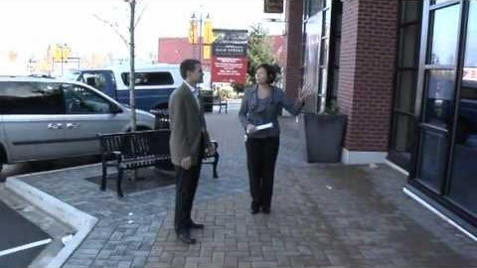
https://www.youtube.com/watch?v=TSRCWxGK7tI&t=214s

Slide 39
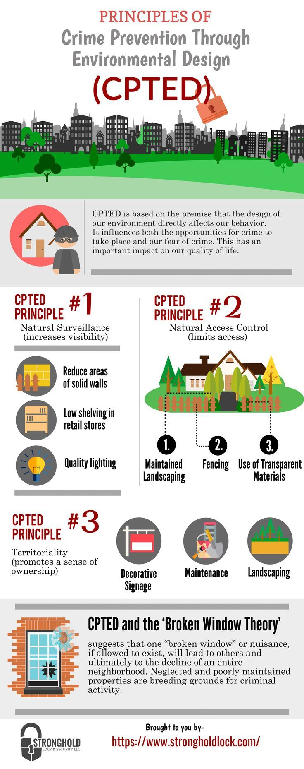
CPTED can reduce crime and fear through:
Territoriality - fostering residents interaction, vigilance, and control over their neighbourhood
Surveillance - maximizing the ability to spot suspicious people and activities
Activity support - encouraging the intended use of public space by residents
Hierarchy of space - identifying ownership by delineating private space from public space through real or symbolic boundaries
Access control/target hardening - using physical barriers, security devices and tamper-resistant materials to restrict entrance
Environment - a design or location decision that takes into account the surrounding environment and minimizes the use of space by conflicting groups
Image/Maintenance - ensuring that a building or area is clean, well-maintained, and graffiti-free

Slide 40
What are the main steps in CPTED projects?
engage the support of residents and other key partners
identify crime and disorder problems in and around the site
analyse current or proposed design based on existing crime problems and potential criminal opportunities
develop preventive or corrective design options
carry out preferred option
monitor and evaluate how the implemented option affects crime, resident surveillance, interaction, and territoriality
disseminate and promote evaluation results

Slide 41
What are some CPTED tactics?
Neighbourhoods:
minimize the number of entry and exit points on a block
design roadways to discourage through-traffic
maximize residents ability to view public spaces
encourage residents use of public spaces
provide appropriate lighting for streets, paths, alleys, and parks
encourage residents to watch over each other
Houses:
clearly delineate private property (e.g., yard, driveway, walkway) from public space (e.g., street, sidewalk) through shrubbery, alternate paving stone colour, and changes in grade
provide unobstructed views of surrounding area
ensure entrances are visible and overlooked by window
avoid landscaping that may conceal offenders
install bright security lights
use solid-core exterior doors
use solid door frames with proper strike plates

Slide 42
Apartment buildings:
provide common spaces to encourage tenant interaction
minimize the number of units sharing a common entrance
equip entrances with an intercom system
ensure hallways are well-lit
install deadbolt locks and peep holes on unit doors
provide children areas that can be easily observed
provide windows that allow for surveillance in laundry rooms
parking lots and garages:
avoid enclosed, underground, multi-story garages
install bright lights over driving lanes and parking spaces
use paint to increase light levels
control access and egress with automatic doors and gates
avoid pillars and recesses that may hide offenders
Public spaces:
encourage use by legitimate users
avoid placing dark, and or hidden areas near activity nodes
install appropriate lighting
avoid placing covered outdoor areas where loitering may be a problem
http://www.bc.rcmp-grc.gc.ca/ViewPage.action?siteNodeId=353&languageId=1&contentId=17345

Slide 43


Slide 44
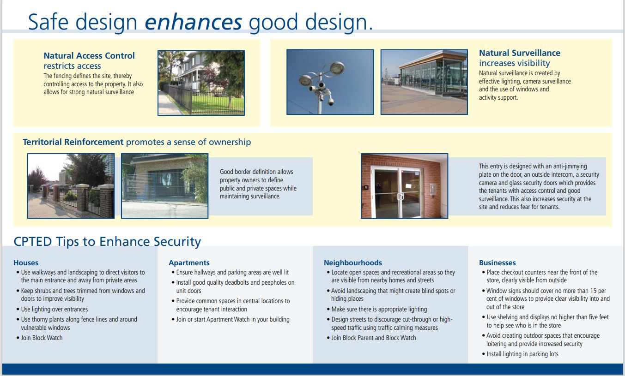
https://www.calgary.ca/cps/community-programs-and-resources/crime-prevention/crime-prevention-through-environmental-design.html

Slide 45
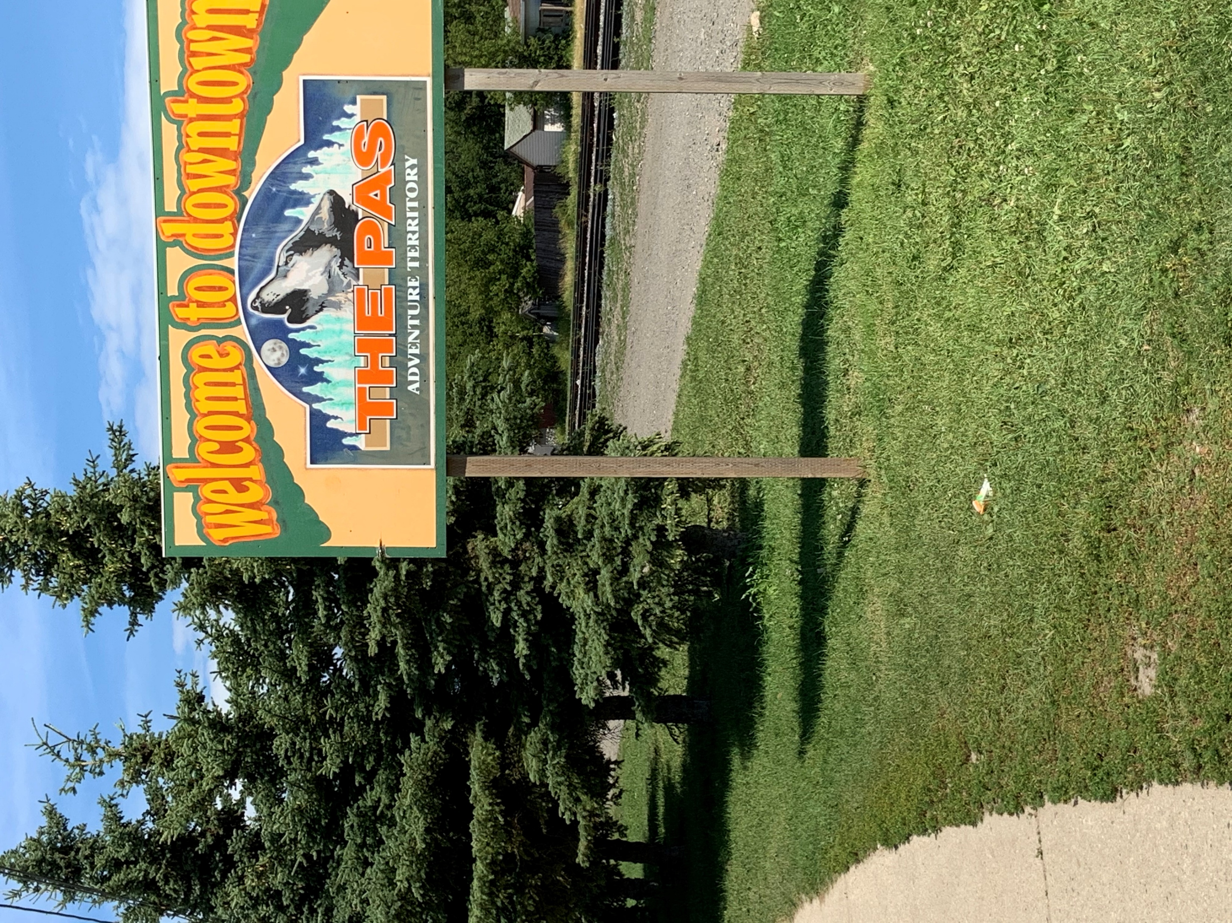
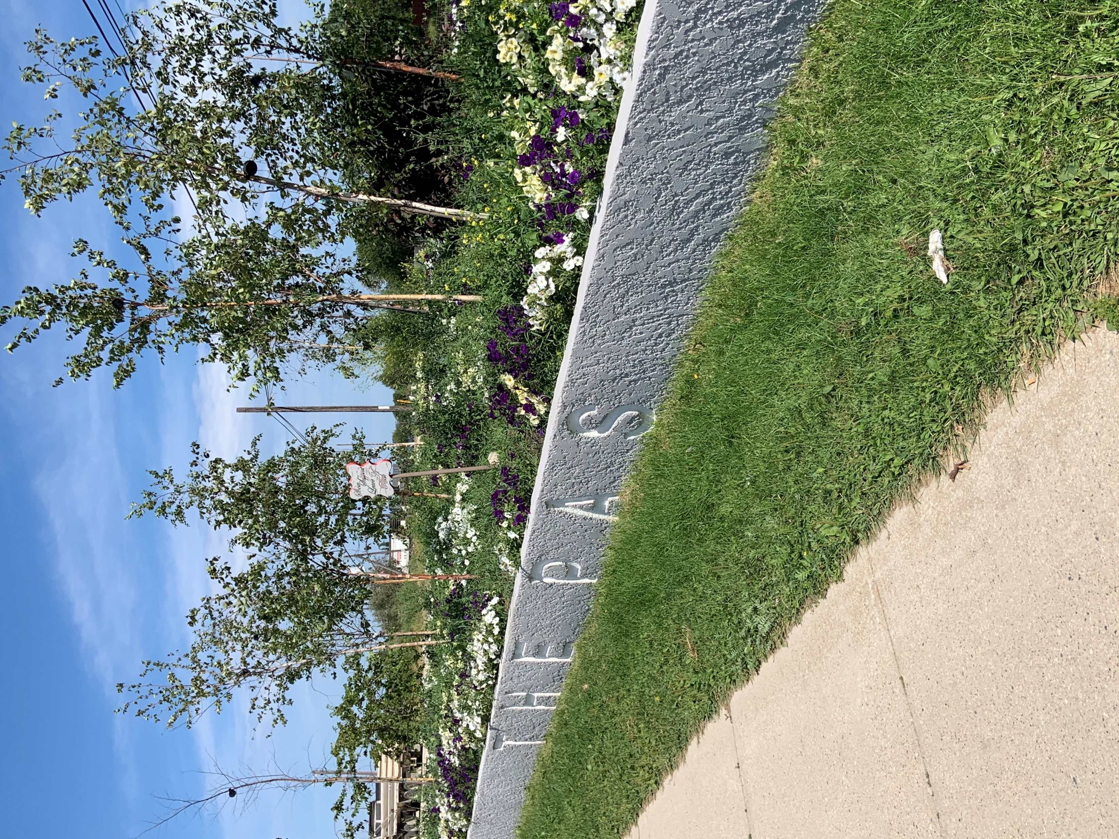
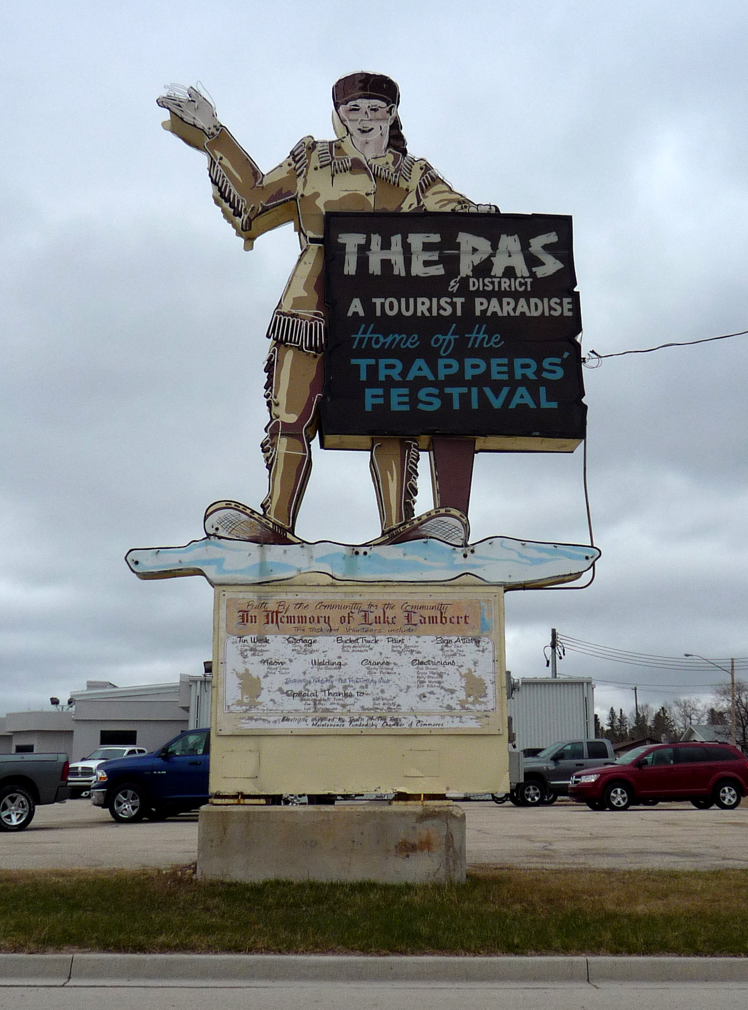
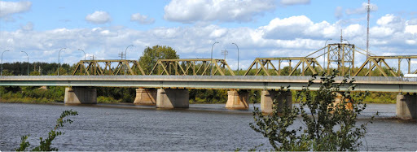
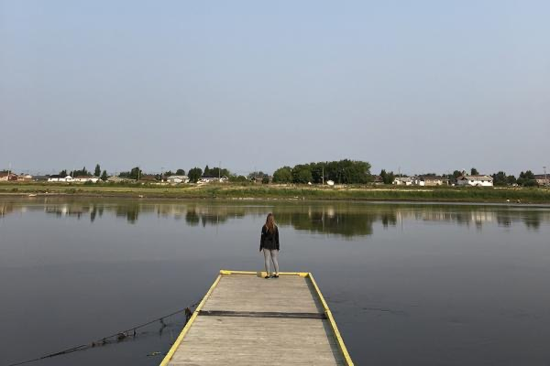
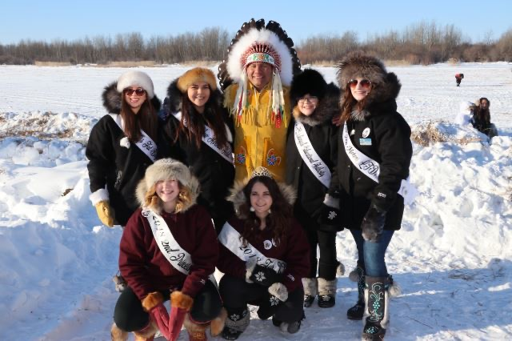
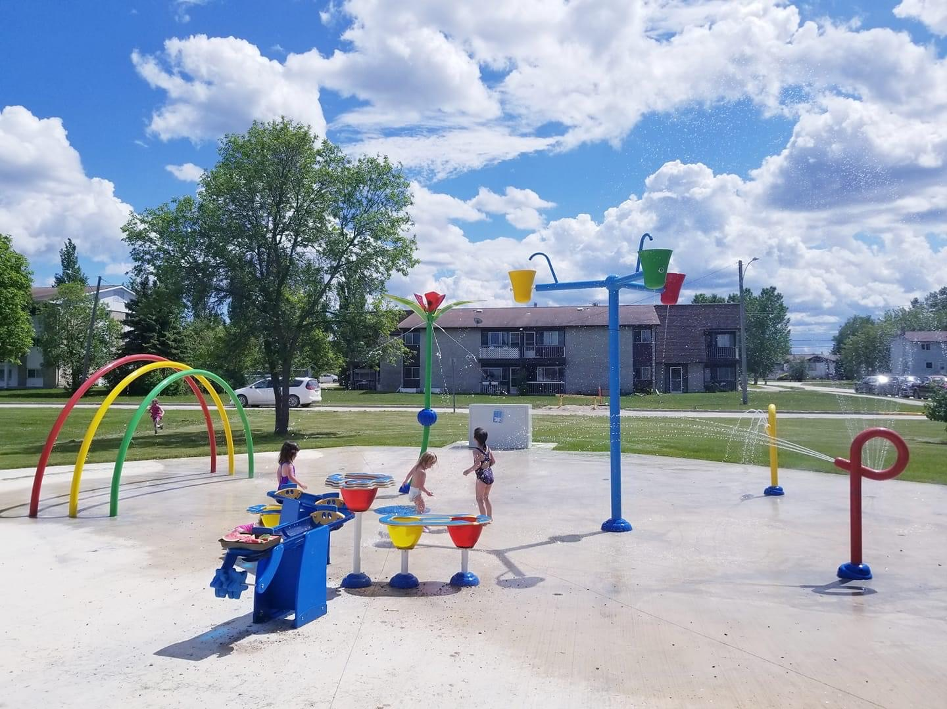
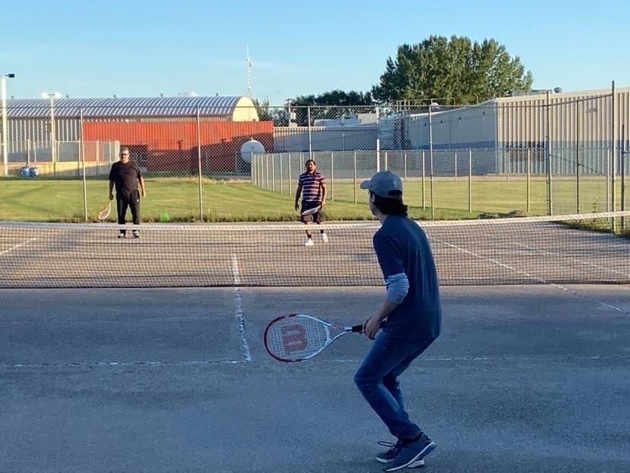
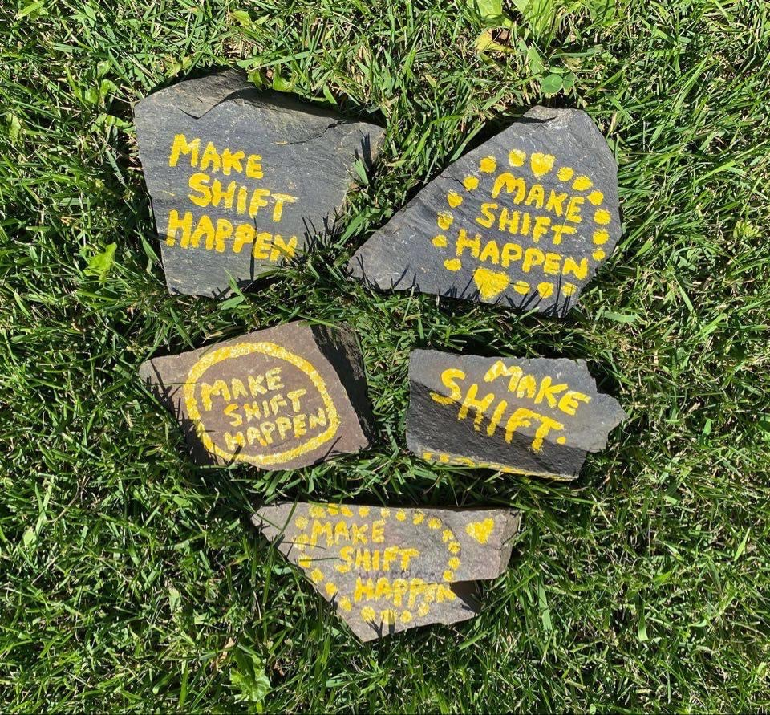
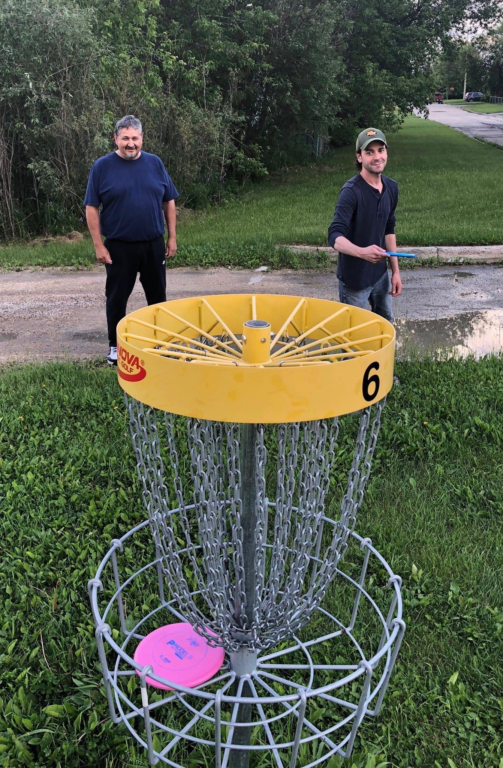

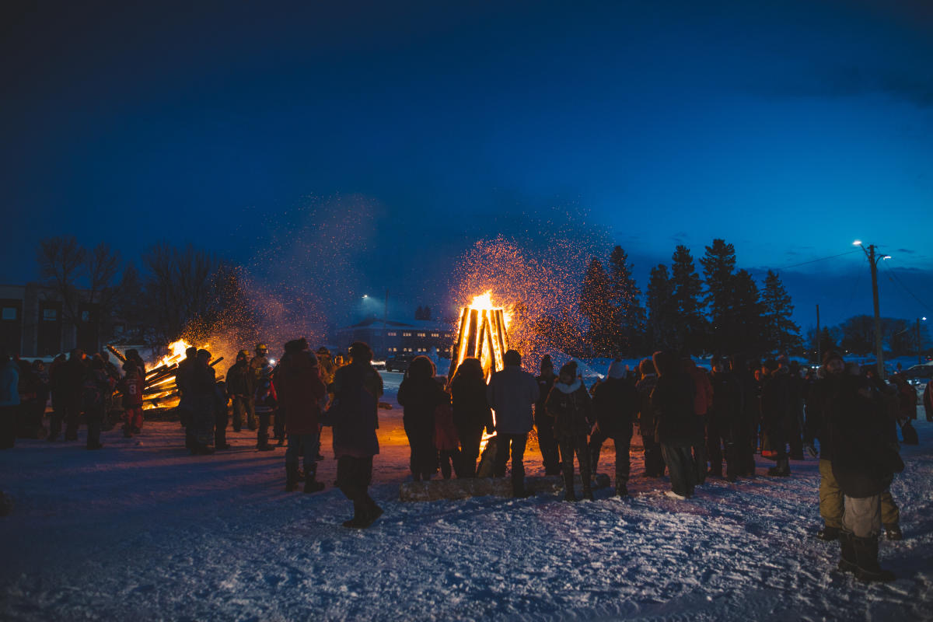
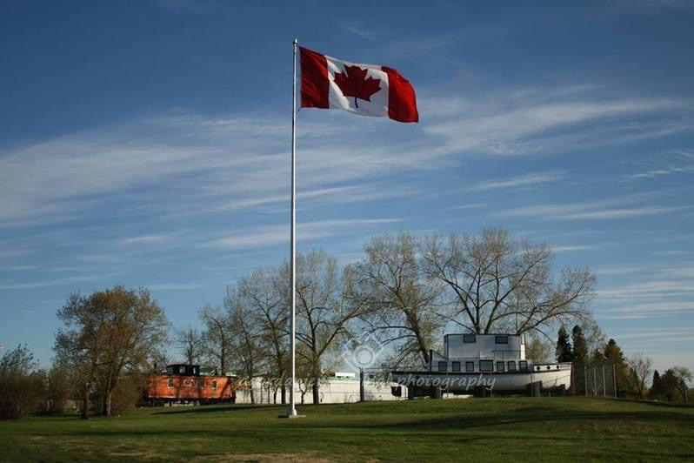
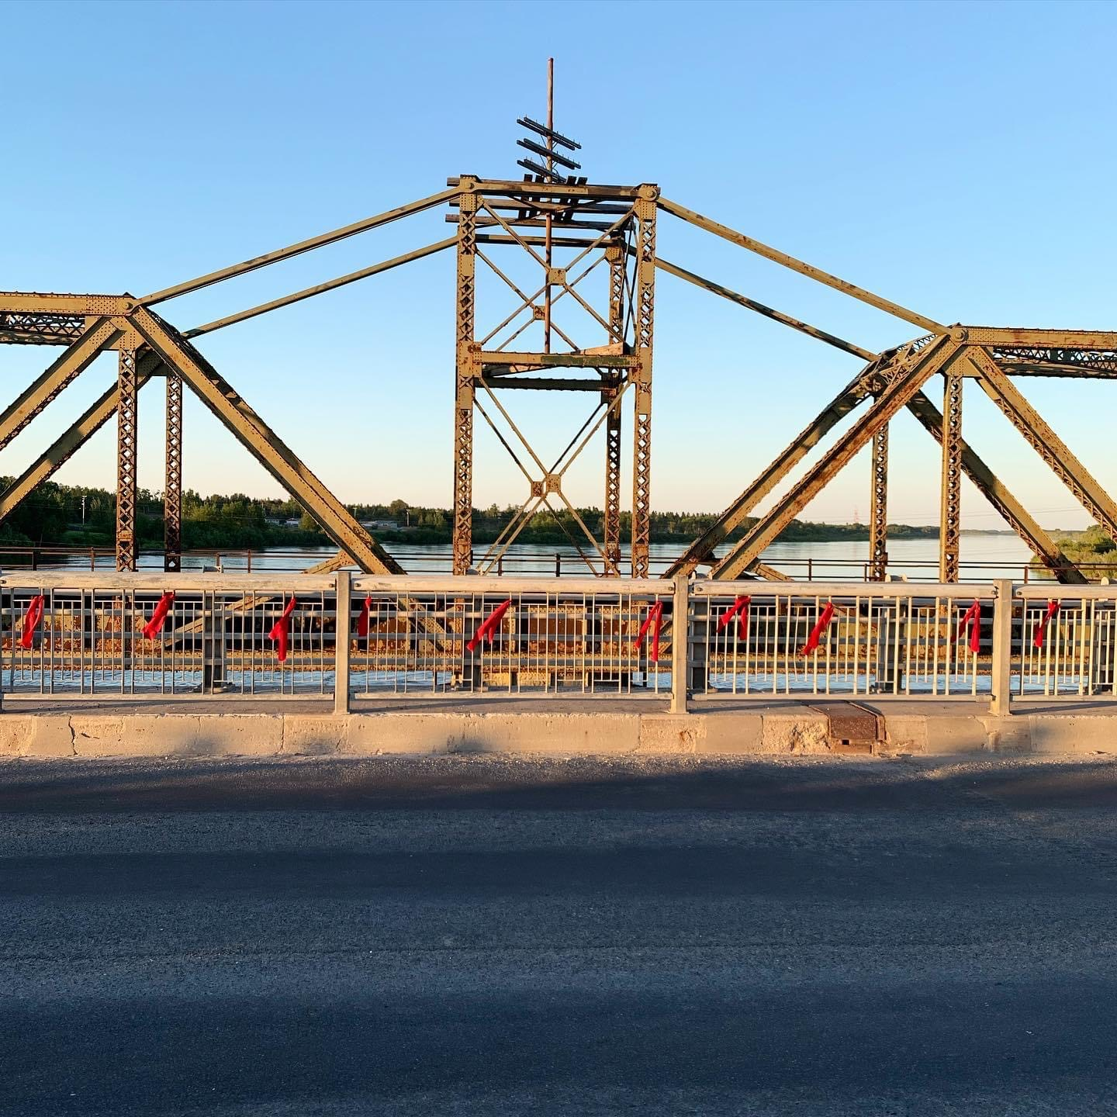
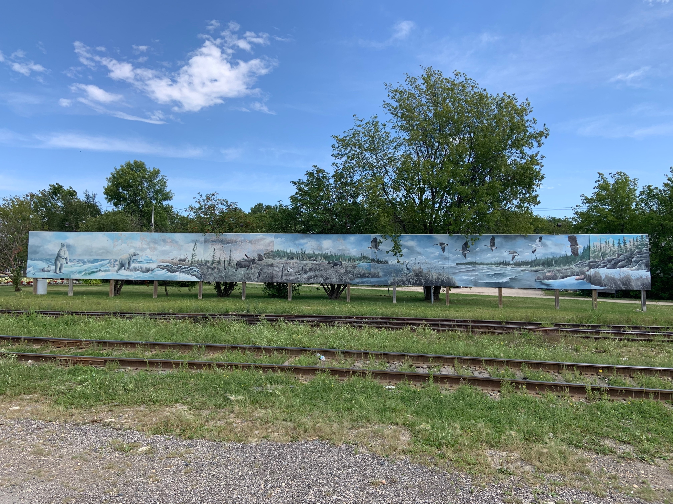
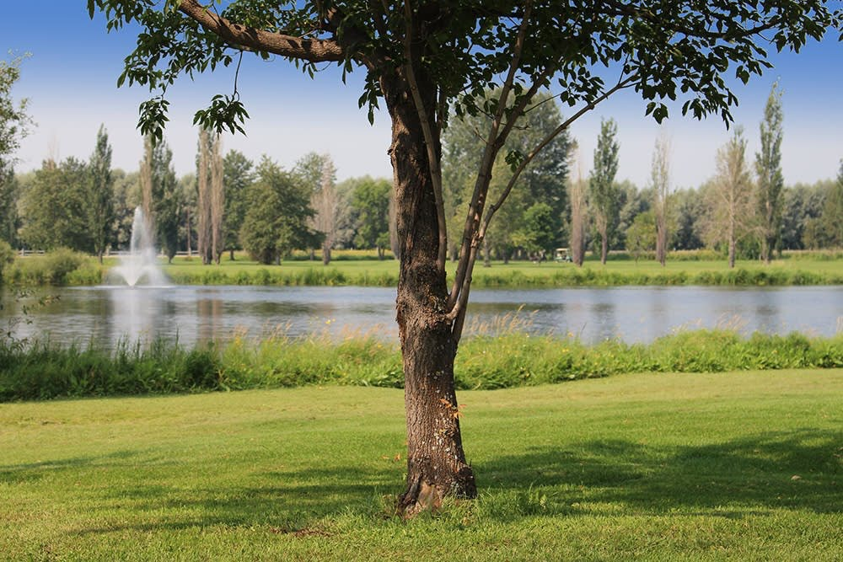

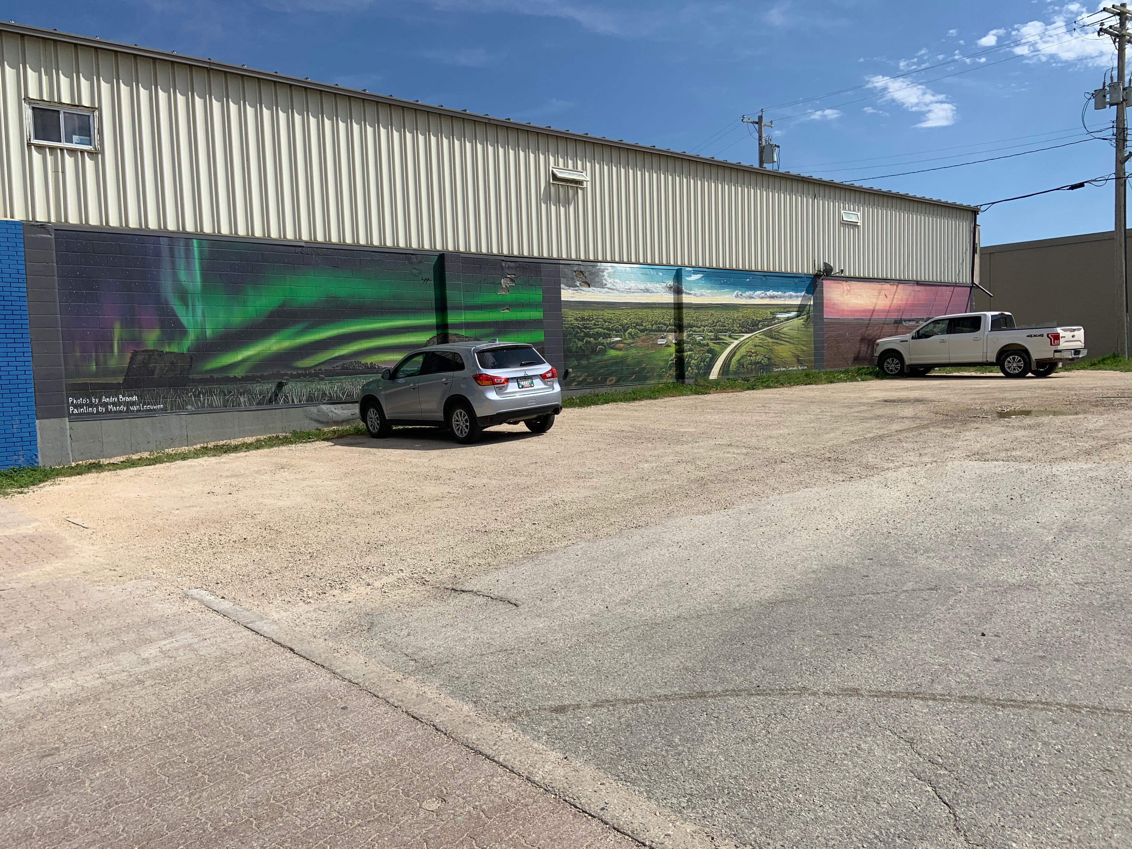
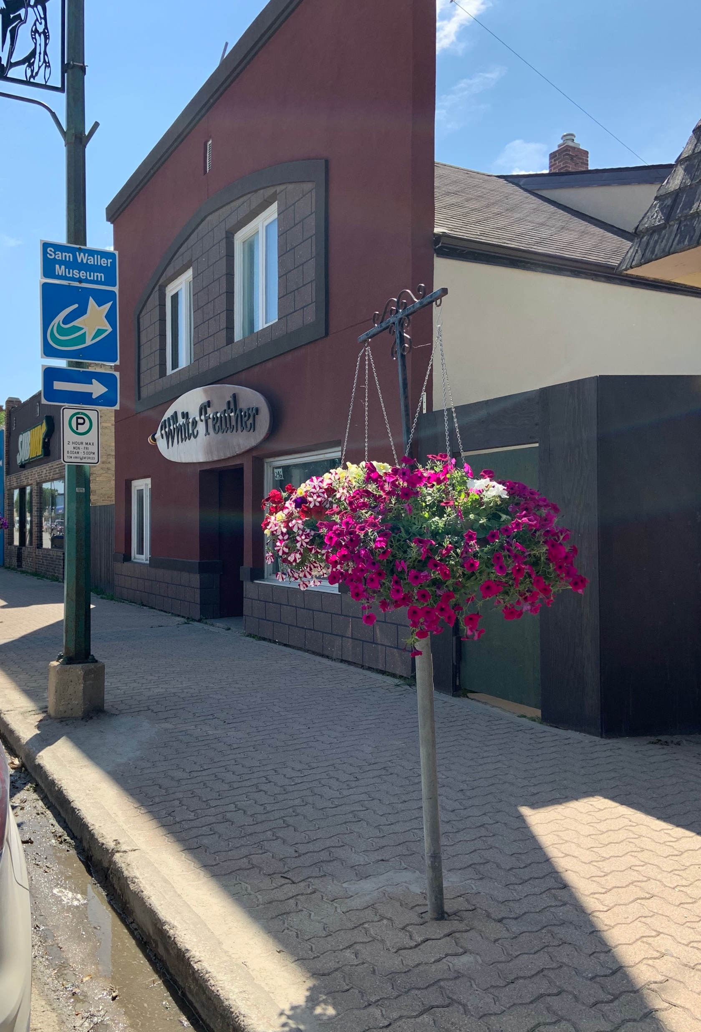
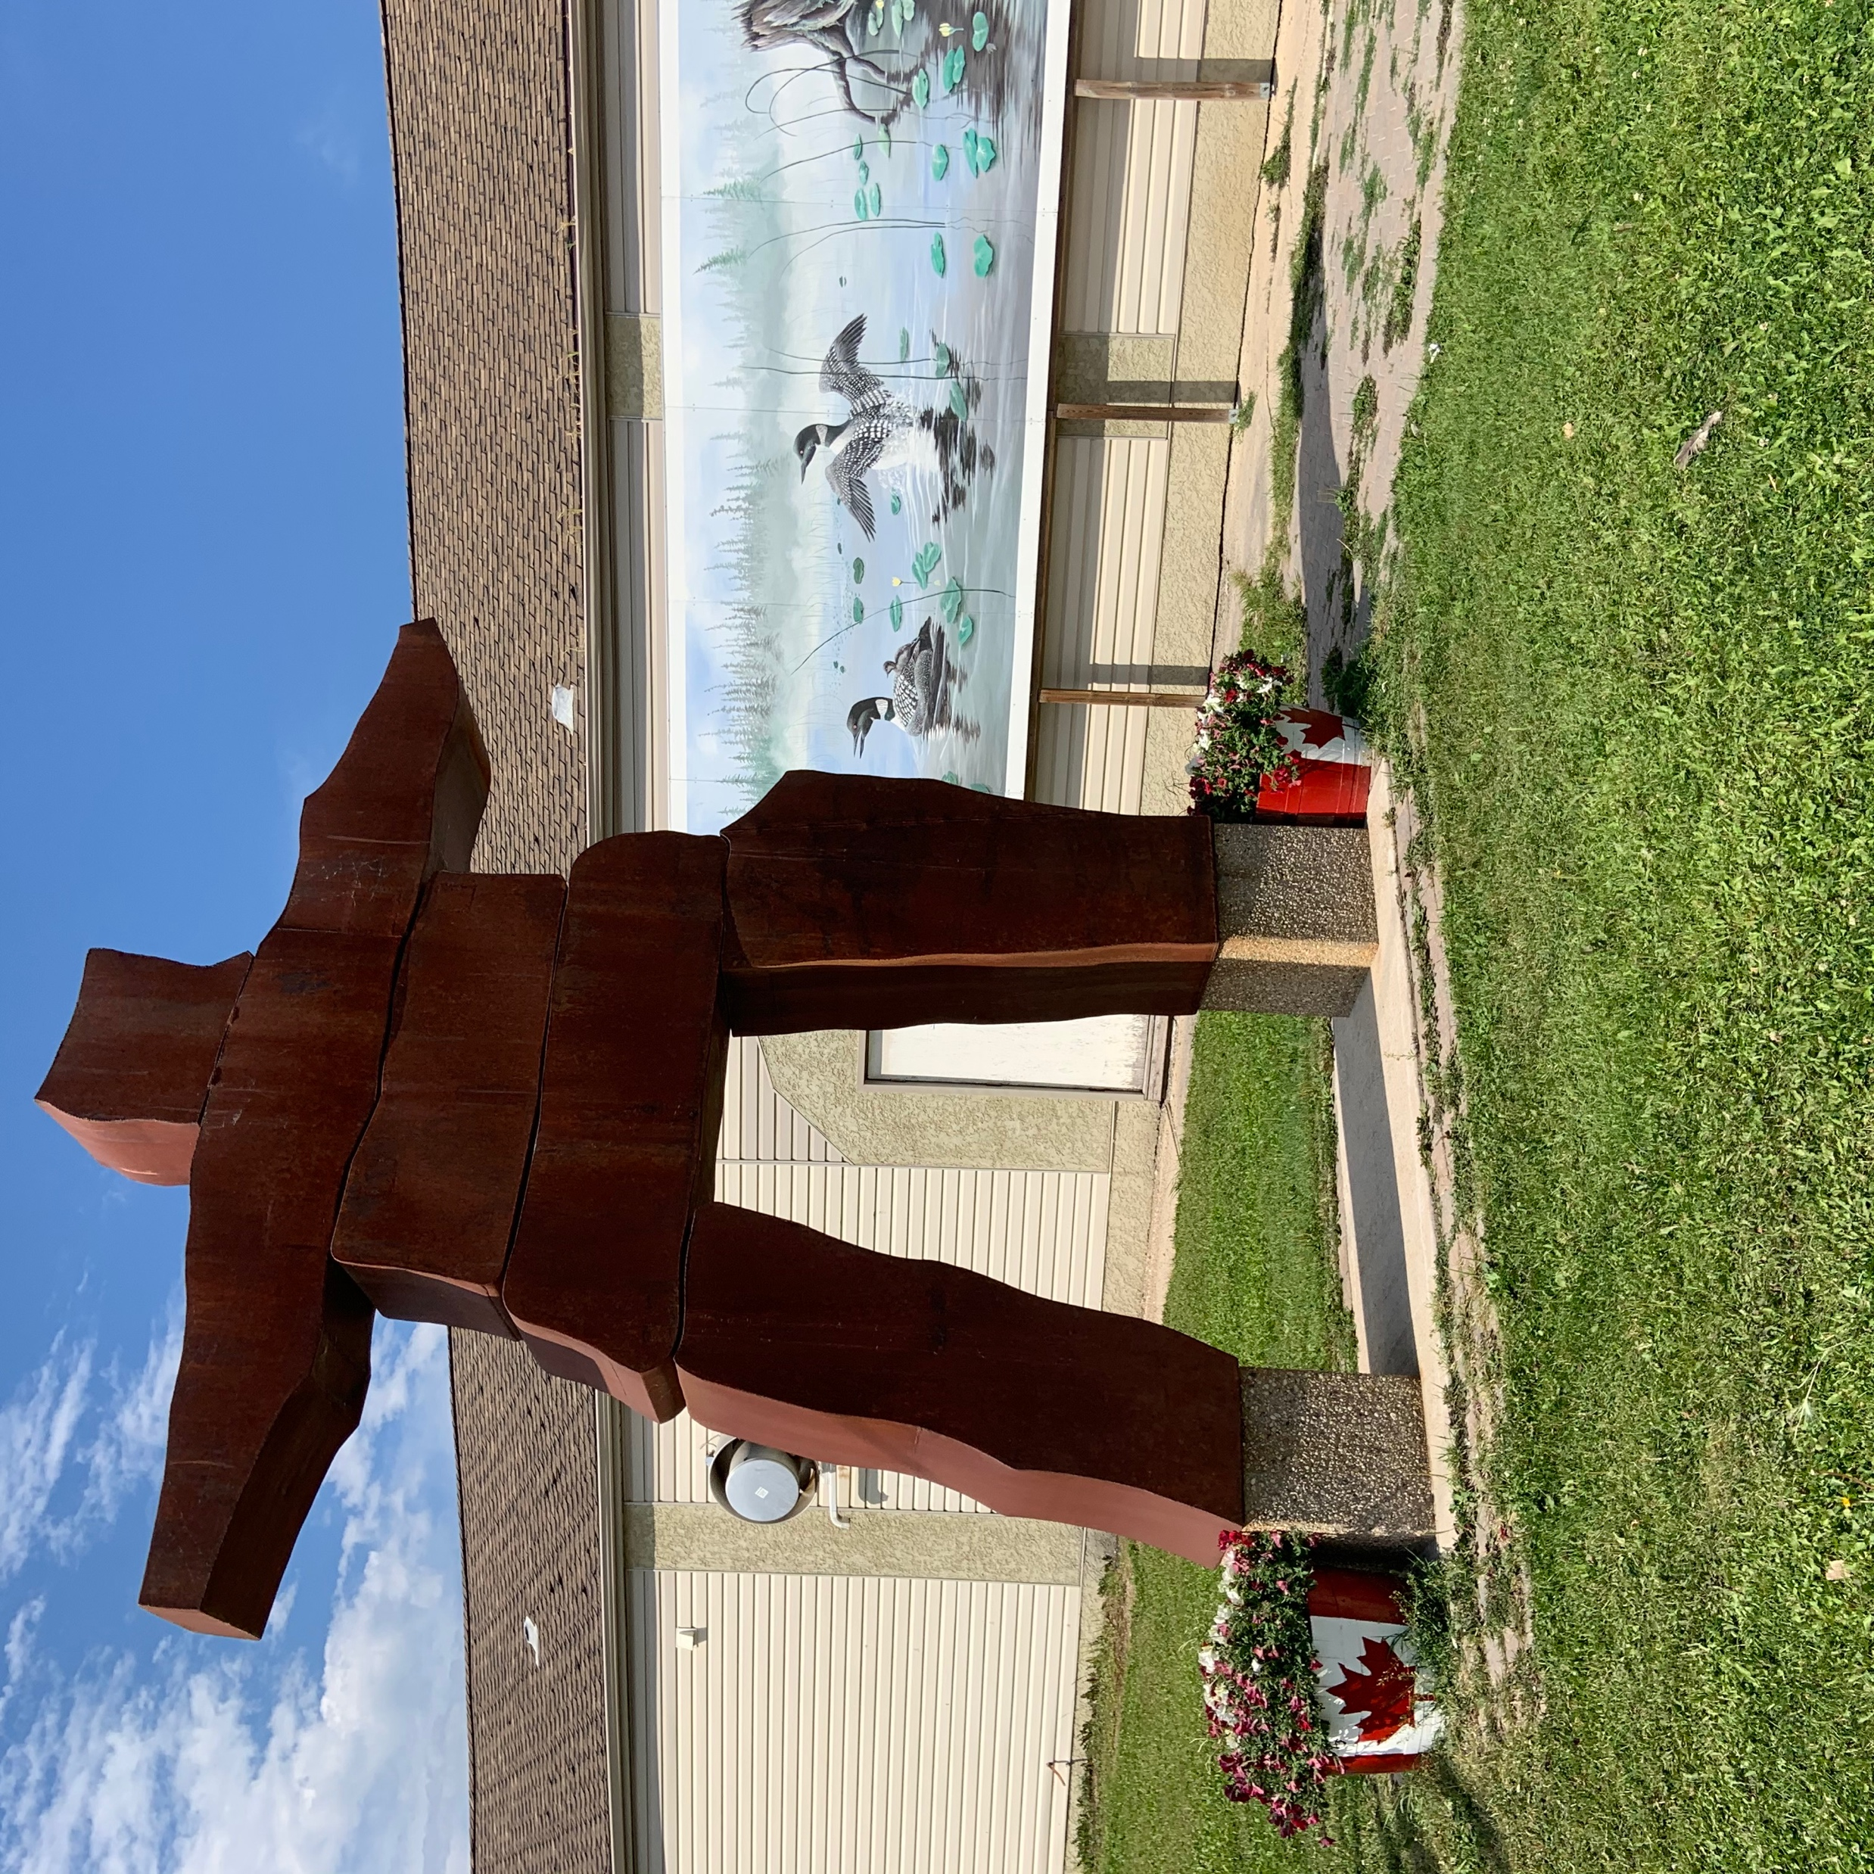
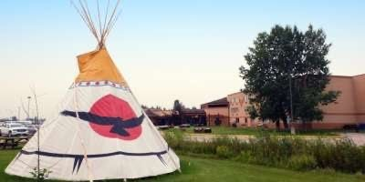
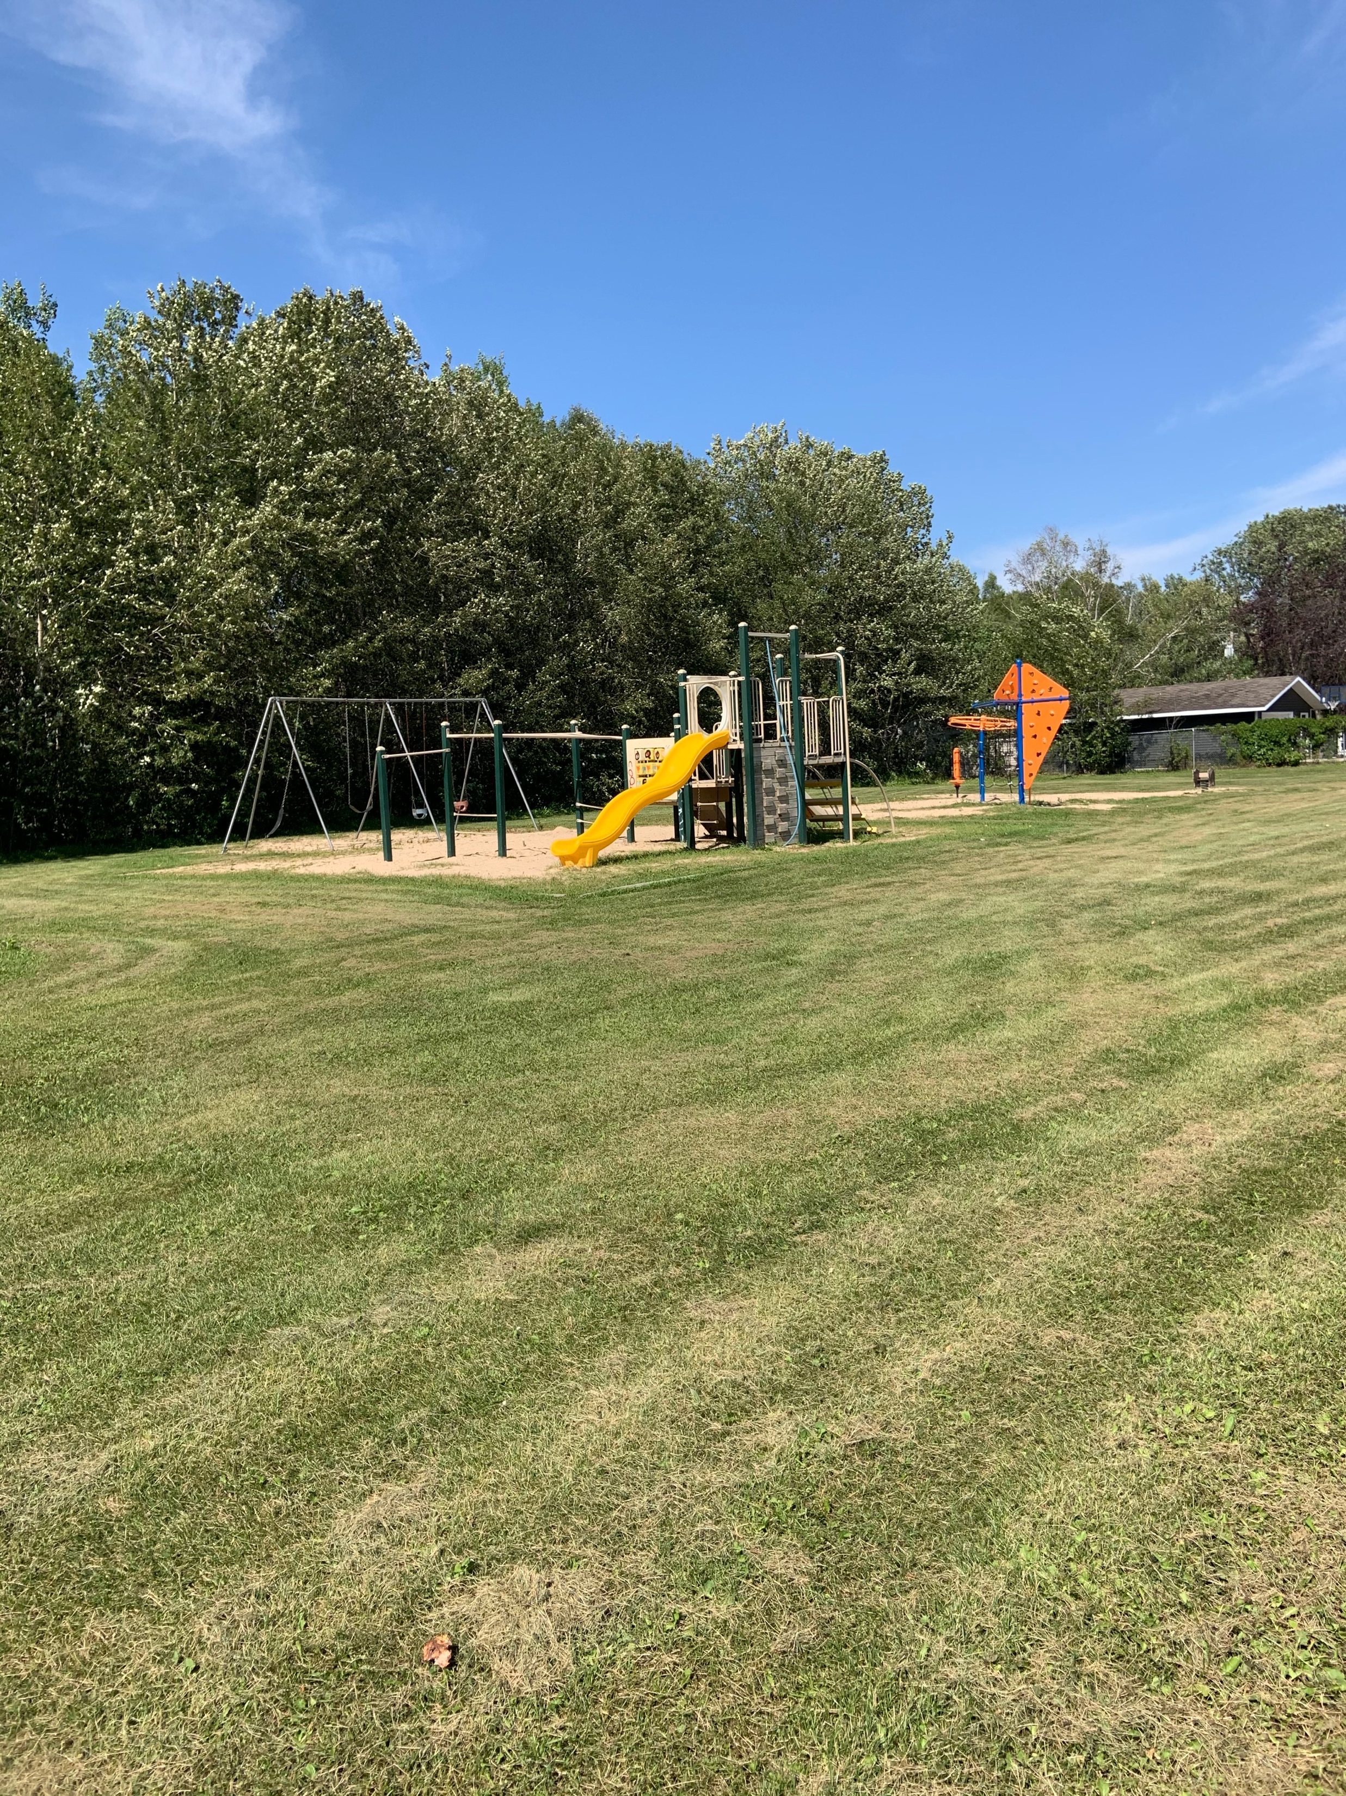
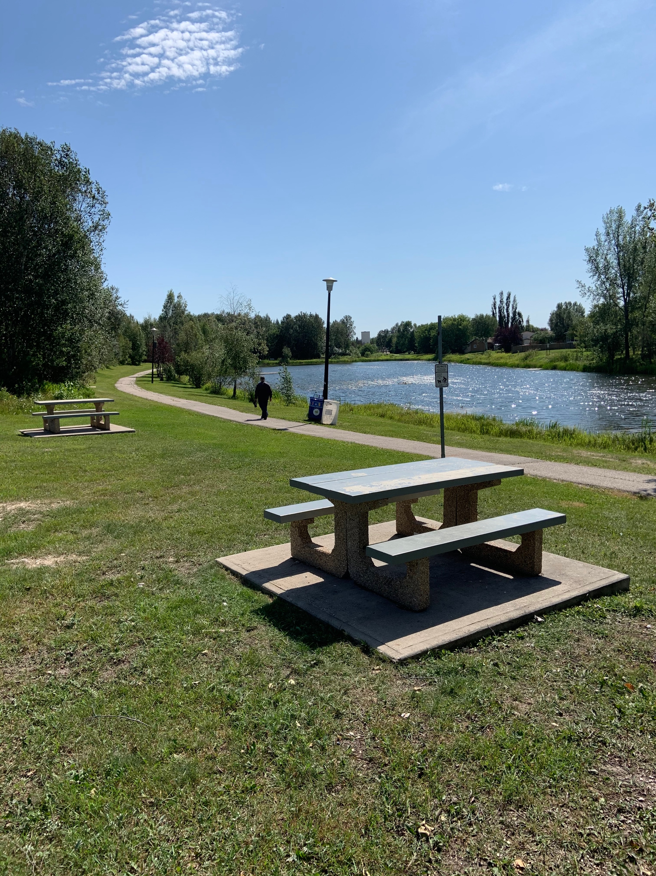
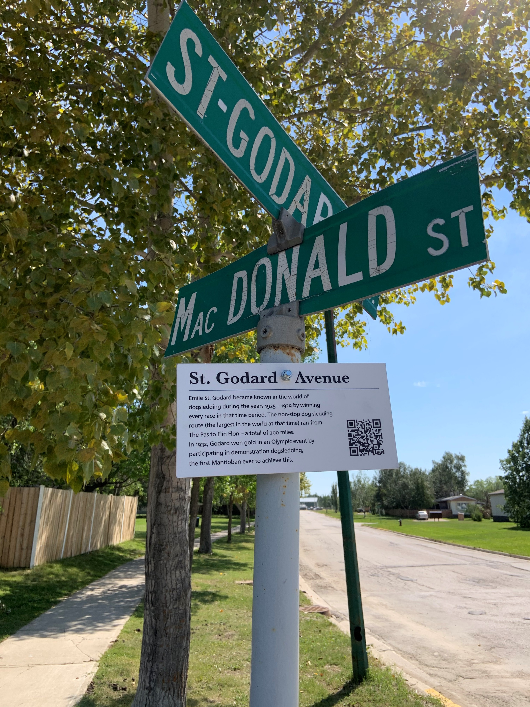
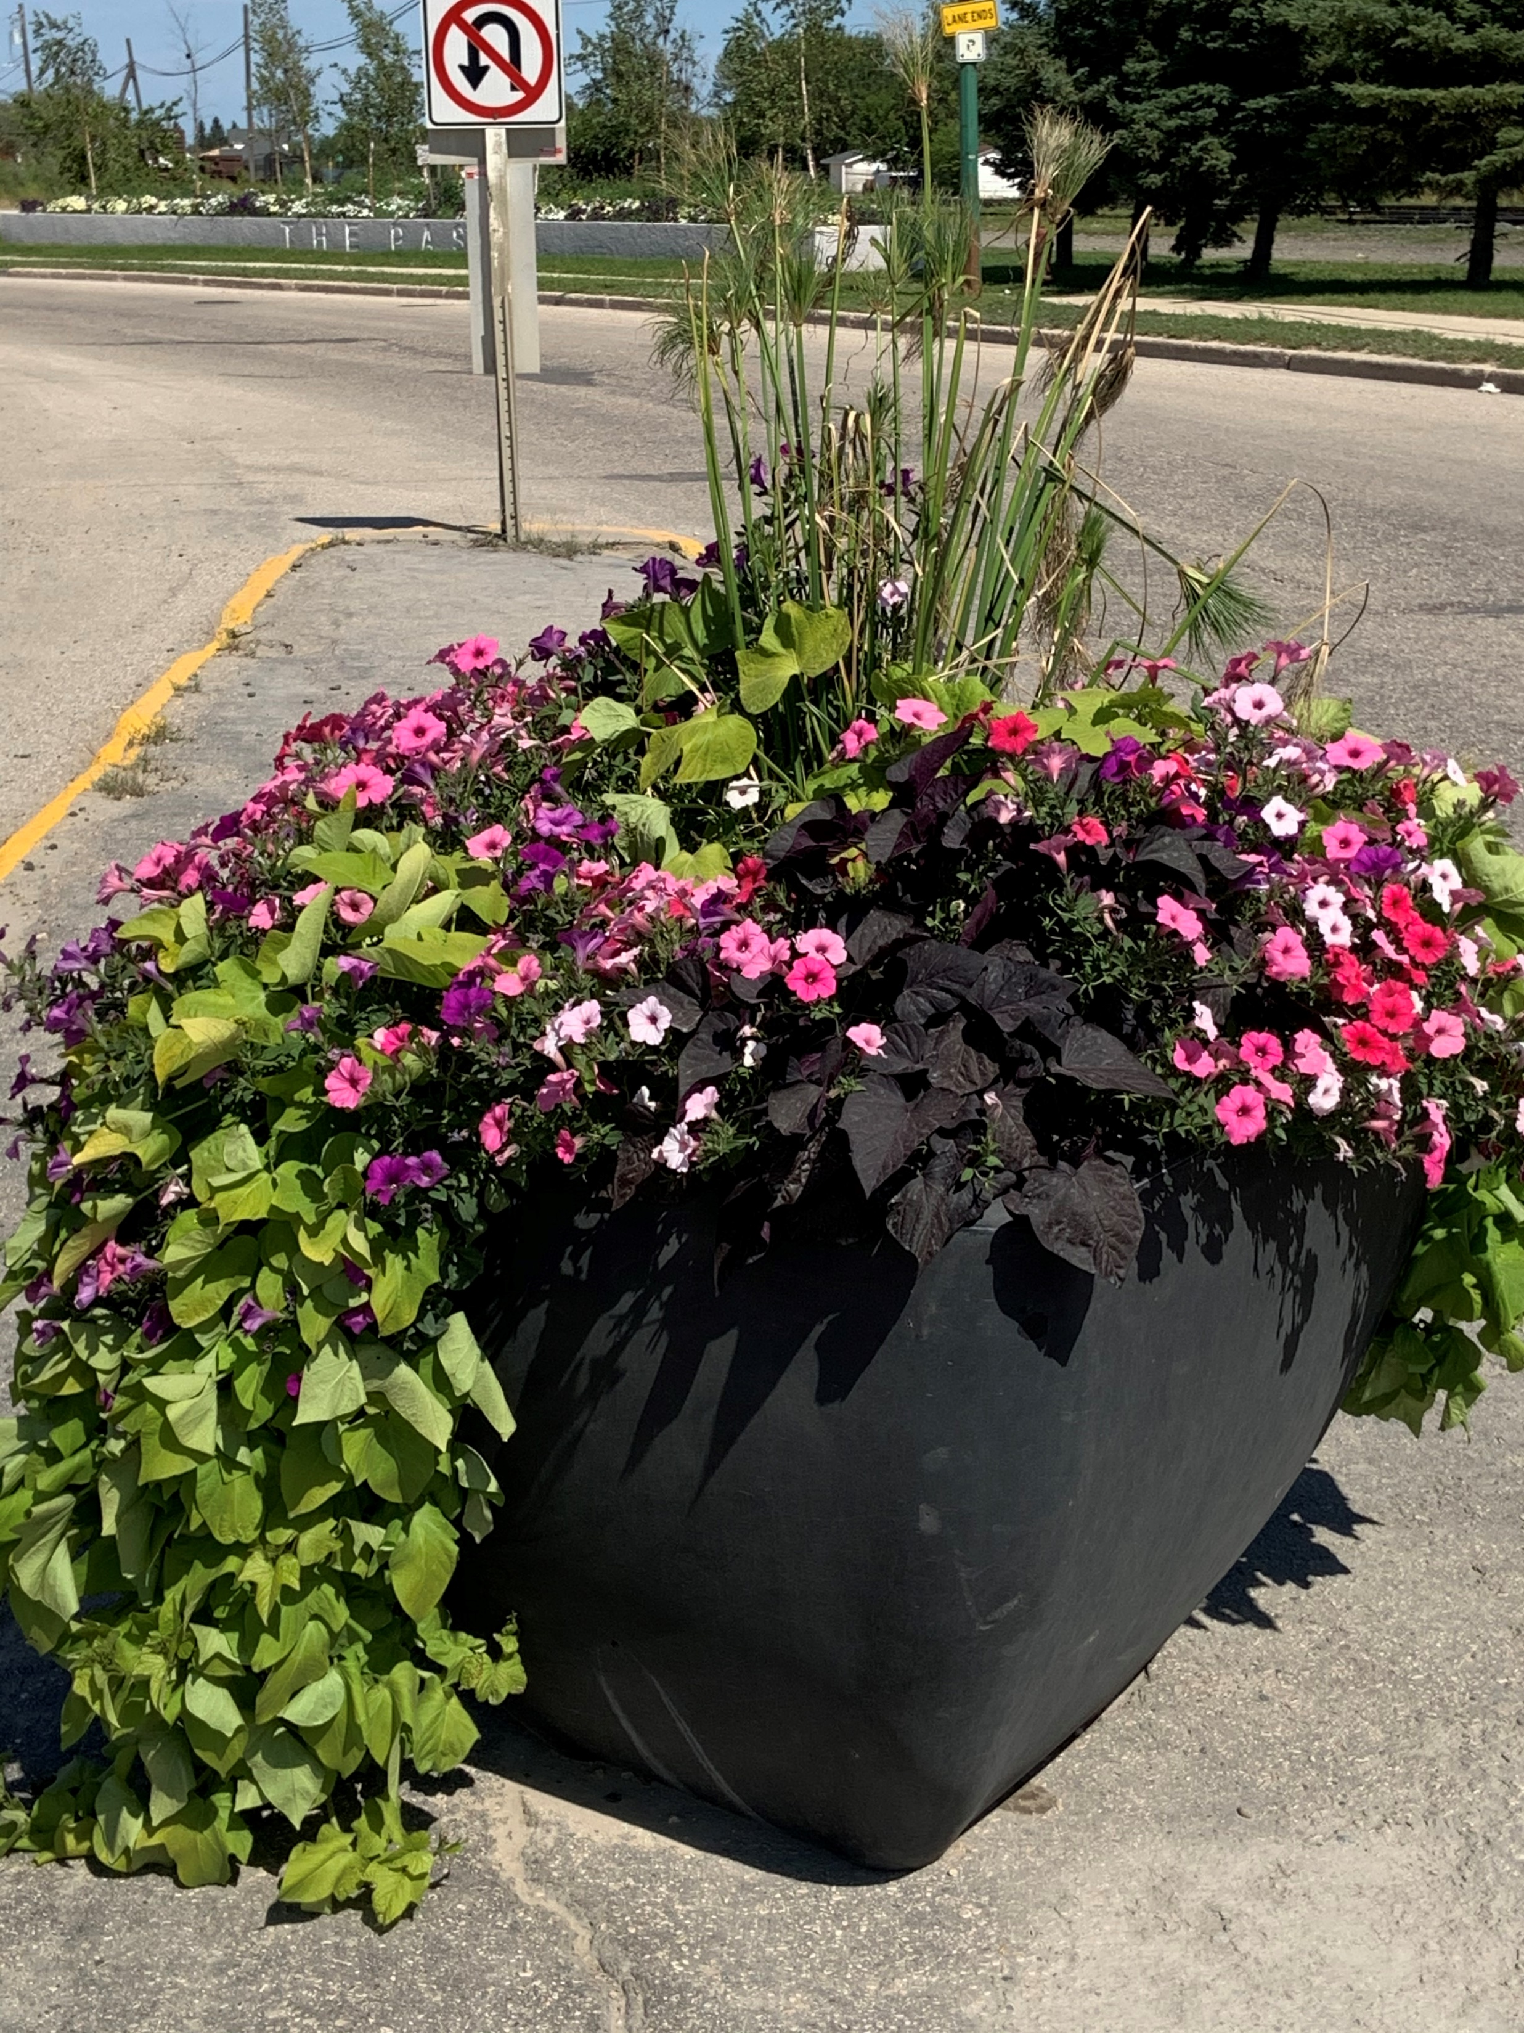
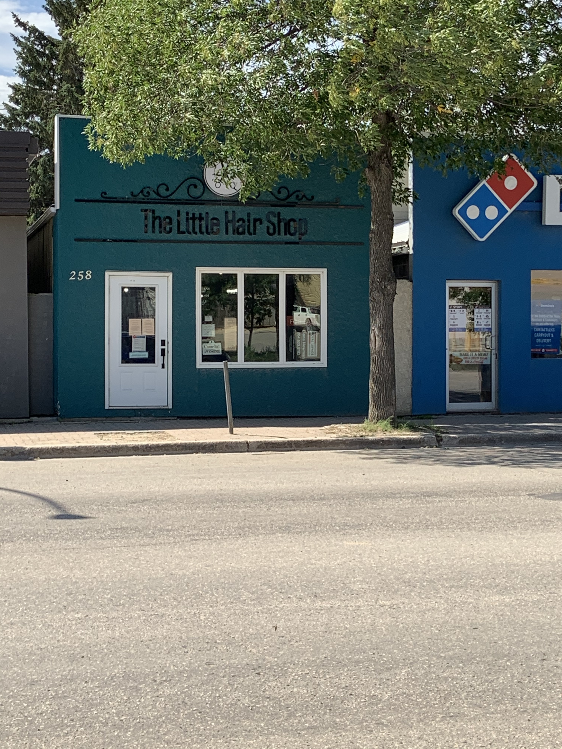
Be A Light-Thomas Rhett

Slide 46
AS A COMMUNITY
WE CAN MAKE
SHIFT
HAPPEN
Prepared by: Amanda Scott
August 2020

